Slide 1
Chapter 3a: Basic Switching Concepts and Configuration (I)
Routing and Switching
Notes:
Cisco Networking Academy program
Routing & Switching
Chapter 2: Basic Switching Concepts and Configuration

Slide 2
Chapter 2a
2.0 Introduction
2.1 Basic Switch Configuration
2.2 Switch Security: Management and Implementation
Notes:
Chapter 2

Slide 3
Chapter 2a: Objectives
Upon completion of this chapter, you will be able to:
Configure initial settings on a Cisco switch.
Configure switch ports to meet network requirements.
Configure the management switch virtual interface.
Configure the port security feature to restrict network access.
Notes:
2.

Slide 4
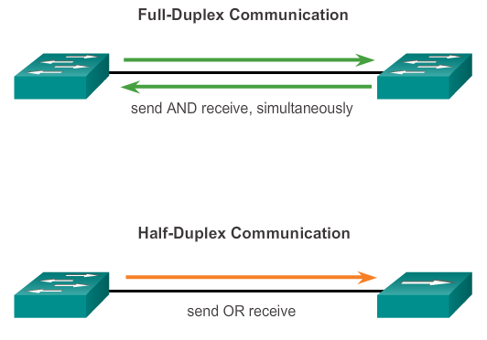
Switch Ports
Duplex Communication
Full-Duplex Communication
  Bi-directional, both ends of the connection can send and receive data simultaneously
Half-Duplex Communication
  Uni-directional, sending and receiving does not occur at the same time.
  Only seen in legacy hardware like hubs. End devices use CSMA/CD to reduce collisions.
hub
Notes:
2.1.2.1 Duplex Communication

Slide 5
Switch Ports
Auto-MDIX Feature
Ethernet straight-through cables are used to connect different types of devices (PC to switch, switch to router)
Ethernet crossover cables are used to connect same types of devices (PC to PC, switch to switch, router to router)
Exception: PC to router requires a crossover cable.
Modern switches are equipped with a feature called “Automatic Medium-Dependent Interface Crossover” (auto-MDIX) such that it doesn’t matter anymore whether a straight or crossover cable is used
When auto-MDIX is enabled, the port interface automatically detects the type of cable and appropriately configures the connection.
Notes:
2.1.2.3 Auto-MDIX Feature

Slide 6
Basic Switch Configuration
Switch Boot Sequence
When a switch is powered on, it goes through the following boot sequence:-
Power-on self test (POST).
Runs the boot loader software which does these:-
  Perform low-level CPU initialization
  Initialize the flash file system
  Locate and load the IOS operating system software image into memory and passes control of the switch over to the IOS
The IOS then initializes the interfaces based on the startup-config stored in NVRAM
Notes:
2.1.1.1 Switch Boot Sequence

Slide 7
Basic Switch Configuration
Basic Switch Configuration
Secure the switch with these basic switch configuration:-
Step 1: Go to the Global Configuration Mode
Switch>enable
Switch#configure terminal
Step 2: Secure the Privileged Exec Mode with a password
Switch(config)#enable secret enable-password
Step 3: Secure the Console with a password
Switch(config)#line console 0
Switch(config-line)#password console-password
Switch(config-line)#login
Step 4: Secure the Virtual Terminal with a password
Switch(config)#line vty 0 15
Switch(config-line)#password telnet-password
Switch(config-line)#login
Notes:
2.1.1.1 Switch Boot Sequence

Slide 8
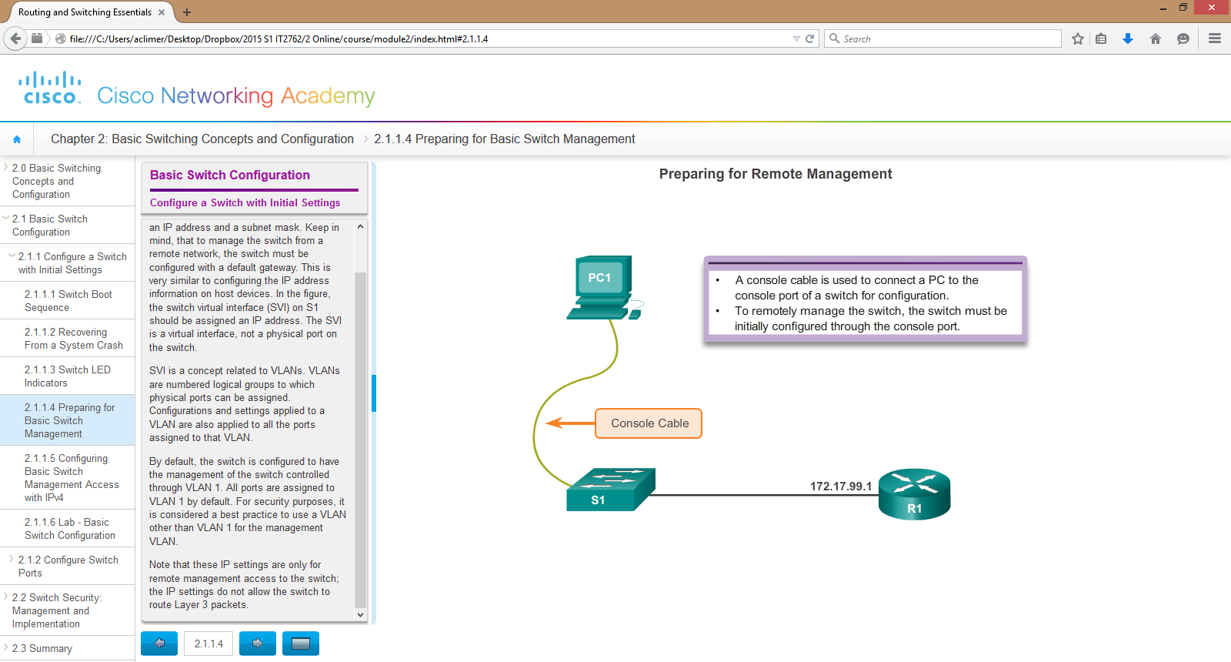
Basic Switch Configuration
Configure a Switch for Remote Access
To remotely manage a switch over the network, it must be configured with an IP address and a subnet mask.
If the switch is to be managed from a different network, the default gateway address must also be configured.
This configuration is configured on the switch to a Switch Virtual interface (SVI).
RS232 port in Packet Tracer
For a new or reset switch in the default state, a console cable allows you to access the command line.
Console port in Packet Tracer
Notes:
2.1.1.4 Preparing for Basic Switch Management

Slide 9
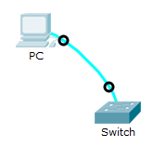
Basic Switch Configuration
Configure a Switch for Remote Access
Step 1: Go to the Global Configuration Mode
Switch>enable
Switch#configure terminal
Step 2: Create the SVI based on the assigned VLAN number (in this example, 99. But the default VLAN is 1). Assign an IP address and subnet mask.
Switch(config)#interface vlan 99
Switch(config-if)#ip address 172.16.99.5 255.255.255.0
Switch(config-if)#no shutdown
Switch(config-if)#exit
Step 3: Assign the default gateway for switch to be managed from another network
Switch(config)#ip default-gateway 172.16.99.1
Switch(config)#exit
Step 4: Save your config and check your configuration
Switch#copy running-config startup-config
Switch#show running-config
Notes:
2.1.1.4 Preparing for Basic Switch Management

Slide 10
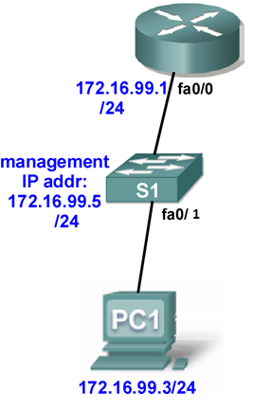
Basic Switch Configuration
Configure a Switch for Remote Access
For the SVI to be functional, the assigned VLAN must eventually be created and a switch port associated with the VLAN
(VLANs will be covered in the next chapter)
Switch(config)#vlan 99
Switch(config-vlan)#exit
Switch(config)#interface fa0/1
Switch(config-if)#switchport mode access
Switch(config-if)#switchport access vlan 99
Configure the basic device configuration (passwords security)
Switch(config)#line vty 0 15
Switch(config-line)#password cisco
Switch(config)#login
The switch can now be accessed via a remote access protocol such as Telnet or SSH (needs additional config) to the SVI IP address.
Notes:
2.1.1.4 Preparing for Basic Switch Management

Slide 11
Basic Switch Configuration
Verifying Switch Configuration
(A) Checking the Running-Config file
Switch#show running-config
<-- top section omitted -->
interface Vlan1
no ip address
shutdown
!
interface Vlan99
ip address 172.16.99.5 255.255.255.0
!
ip default-gateway 172.16.99.1
!
!
line con 0
!
line vty 0 4
password cisco
login
line vty 5 15
password cisco
login
!
end
SVI configuration
Default gateway address
Telnet enabled
Notes:
2.1.2.4 Verifying Switch Port Configuration

Slide 12
Basic Switch Configuration
Verifying Switch Configuration
(B) Checking the Port Interface Status
Switch#show ip interface brief
Interface IP-Address OK? Method Status Protocol
FastEthernet0/1 unassigned YES manual up up
FastEthernet0/2 unassigned YES manual down down
<-- mid section omitted -->
Vlan1 unassigned YES manual administratively down down
Vlan99 172.16.99.5 YES manual up up
(C) Checking the MAC address table
Switch#show mac-address-table
Mac Address Table
-------------------------------------------
Vlan Mac Address Type Ports
---- ----------- -------- -----
10 0001.c9a9.c942 DYNAMIC Fa0/2
99 0001.4272.ac90 STATIC Fa0/1
SVI is up/up
Notes:
2.1.2.4 Verifying Switch Port Configuration

Slide 13
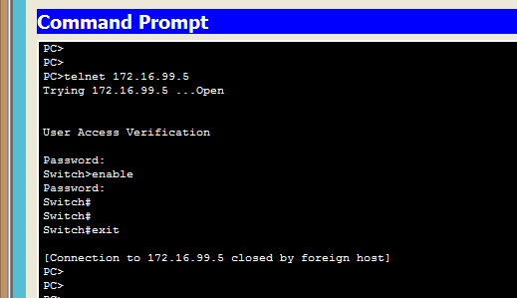
Security Concerns in LANs
Switch Remote Access using Telnet
Telnet can be exploited:
  Brute force password attack
  Telnet DOS attack
Telnet is insecure and replaced by SSH (secure shell). For learning purpose, we will still use Telnet for remote access to a switch
Notes:
2.2.2.4 Leveraging Telnet

Slide 14
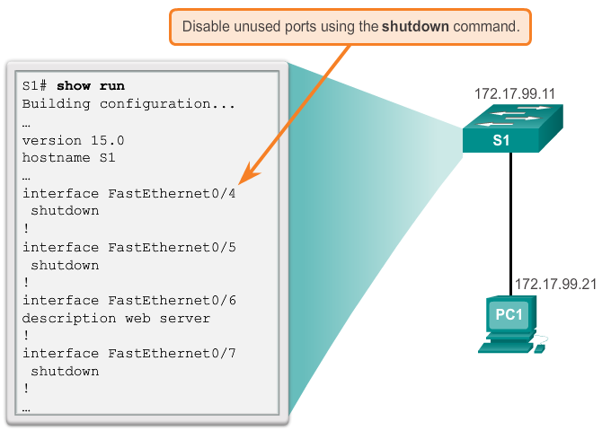
Switch Port Security
Secure Unused Ports
Switch ports are enabled by default
Disabling (shutdown) unused ports is a simple and efficient security guideline.
Notes:
2.2.4.1 Secure Unused Ports

Slide 15
Switch Port Security
Port Security: Operation
Another way to secure a port is to configure a feature called Port Security
Port security limits the number of valid MAC addresses allowed and checks the MAC addresses of devices before allowing access.
Any attempt to connect by unknown MAC addresses causes a violation.
Secure MAC addresses can be configured in 3 ways:
  Static secure MAC addresses
    Manually specified by a network administrator
    Stored in running-config and the MAC address table
  Dynamic secure MAC addresses
    Learned dynamically and stored in MAC address table only
  Sticky secure MAC addresses
    Learned dynamically
    Stored in running-config and the MAC address table
Notes:
2.2.4.3 Port Security: Operation

Slide 16
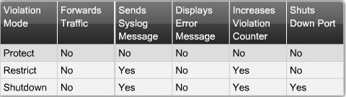
Switch Port Security
Port Security: Operation
Port security is disabled by default and must be manually enabled on each port
Port security generally involves:-
  Setting the number of MAC addresses allowed on a port interface
  Specifying 1 of 3 types of violation action to be taken
Configured on access ports only
Security violation modes:-

Slide 17
Switch Port Security
Port Security: Operation
To enable port security on an access port interface:-
(config)#interface fa0/1
(config-if)#switchport mode access
(config-if)#switchport port-security
(config-if)#switchport port-security mac-address [ MAC | sticky ]
(config-if)#switchport port-security maximum max-#
(config-if)#switchport port-security violation [ protect | restrict | shutdown ]
(config-if)#switchport port-security ?
(This command enables
port-security on the port)
Use “?” to view options
Notes:
Note: switchport port-security without keywords enable port security on the interface.
Defaults are: maximum number of secure MAC addrs is 1.
sticky learning is disabled.
violation is shutdown.
Sticky – mac address that is learned is placed in the configuration file (don’t lose it).
Port security can only be configured on static access ports. (Not on dynamic, dynamic access, or trunk ports).

Slide 18
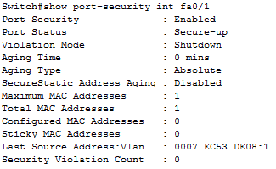
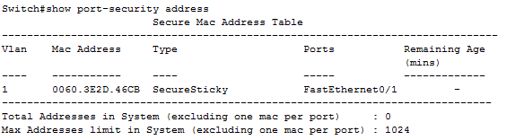
Switch Port Security
Port Security: Verify
To verify port security:-
  #show port-security interface interface
  #show port-security address
Port security default mode:-
Sticky learning is disabled
Max addresses is 1
Violation mode is shutdown
Sticky secure MAC; MAC will be in running-config as well
Notes:
18

Slide 19
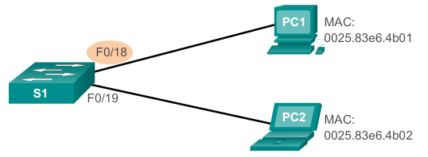
Switch Port Security
Port Security: Static Secure Config
Example: Manually configuring port fa0/18 for PC1 access only
S1(config)#interface fa0/18
S1(config-if)#switchport mode access
S1(config-if)#switchport port-security
S1(config-if)#switchport port-security mac-address 0025.83e6.4b01
S1(config-if)#switchport port-security violation shutdown
Q1: Where would you verify this MAC address?
Q2: What happens when the switch is rebooted but the running-config file has not been saved to the startup-config file?

Slide 20
Switch Port Security
Port Security: Dynamic Secure Config
Example: Configure port Fa0/18 to allow any first 2 PCs to access the port with violation set to “protect”
S1(config)#interface fa0/18
S1(config)#switchport mode access
S1(config)#switchport port-security
S1(config)#switchport port-security maximum 2
S1(config)#switchport port-security violation protect

Slide 21
Switch Port Security
Port Security: Sticky Secure Config
Example: Configuring port fa0/18 to learn the MAC address of PC1 and any 2nd PC after PC1
S1(config)#interface fa0/18
S1(config)#switchport mode access
S1(config)#switchport port-security
S1(config)#switchport port-security mac-address sticky
S1(config)#switchport port-security maximum 2
S1(config)#switchport port-security violation shutdown
Q1: Where would you verify these 2 MAC addresses?

Slide 22
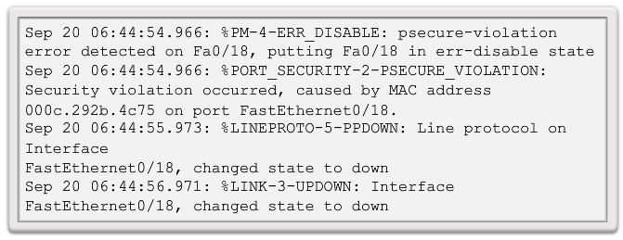
Switch Port Security
Ports in Error Disabled State
A device with a different MAC address accessing the port will trigger a security violation causing an error-disabled state on the port which shuts down the port.
The switch communicates these events through console messages.
Notes:
2.2.4.7 Ports in Error Disabled State

Slide 23
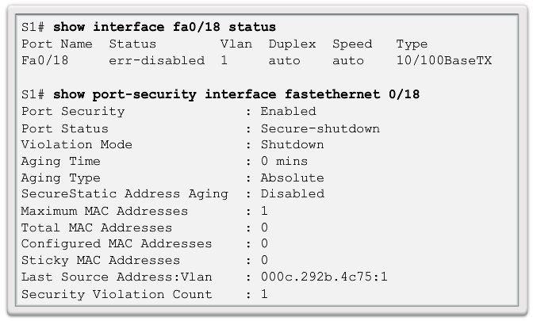
Switch Port Security
Ports in Error Disabled State (cont.)
The show interface command also reveals a switch port on error disabled state.
As opposed to “Secure-up”
Notes:
2.2.4.7 Ports In Error Disabled State

Slide 24
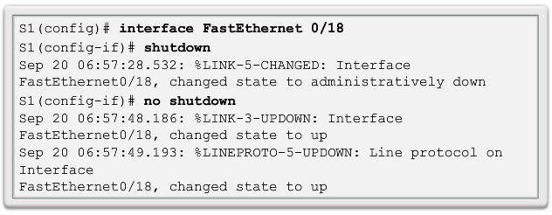
Switch Port Security
Ports in Error Disabled State (cont.)
To re-enable an error-disabled port, shutdown and bring the port back up as shown:-
Notes:
2.2.4.7 Ports In Error Disabled State

Slide 25
Chapter 3a: Summary
In this chapter, you learned:
Cisco LAN switch boot sequence.
How to remotely access and manage a Cisco LAN switch
Cisco LAN switch port duplex modes.
Cisco LAN switch port security, violation modes, and actions.
Notes:
Chapter 2 Summary

